Slide 1

What is AI Tool Sprawl?
How to Identify and Measure It in Your Organization
https://peridot.company
© Copyright 2026 Peridot

Slide 2


AI Adoption Doesn't Scale Neatly. It Spreads.
Teams Act Independently
Employees Experiment
Individuals spin up AI tools on their own — often on personal accounts.
Departments adopt tools without coordination or central approval.
AI Gets Embedded
Existing software quietly adds AI capabilities, often without notice.
The result: No visibility. No coordination. And growing risk across the organization.
https://peridot.company
© Copyright 2026 Peridot

Slide 3
Defining AI Tool Sprawl
Multiple Tools
Redundant or overlapping AI tools in use across teams.
AI tool sprawl is the uncontrolled expansion of AI tools across an organization — multiple tools operating without centralized visibility or governance.
No Central Visibility
It's not about volume. It's about the absence of coordination and control. An org with 50 tools and clear ownership is healthier than one with 10 tools and no oversight.
No one has a complete picture of what's deployed where.
No Governance
Usage policies are absent, inconsistent, or unenforced.
https://peridot.company
© Copyright 2026 Peridot

Slide 4
Why It Matters: Sprawl Equals Risk
As AI tool sprawl increases, organizational control decreases. The complexity introduced by ungoverned AI usage creates compounding risk.
No Tool Inventory
Shadow AI Usage
You can't govern what you can't see. Most orgs lack a complete list of active AI tools.
Employees use unapproved tools outside IT's visibility — often with real business data.
Inconsistent Policies
Data Exposure Risk
Different teams apply different standards, creating enforcement gaps.
Sensitive data flows into external AI models without oversight or consent controls.
https://peridot.company
© Copyright 2026 Peridot

Slide 5


WHY THIS IS DIFFERENT
AI Sprawl Is Harder to Control Than SaaS Sprawl
Faster Adoption
No procurement cycle. No IT ticket. A tool can be in use within minutes.
Personal Account Usage
Employees use consumer-tier AI on personal accounts — invisible to the organization.
Embedded Everywhere
AI is silently added to tools your teams already use — no separate install required.
Less visibility. Higher risk. Faster moving target.
https://peridot.company
© Copyright 2026 Peridot

Slide 6
Four Types of AI Tool Sprawl
Sprawl isn't one-dimensional. It shows up across tools, data, access, and workflows simultaneously.
Tool Sprawl
Data Sprawl
Too many AI tools in use, often duplicating the same functionality across teams.
Organizational data flows across multiple AI tools without tracking or control.
Access Sprawl
Workflow Sprawl
Uncontrolled and ungoverned usage — anyone can use anything, anytime.
AI is baked into existing processes and products, making it hard to audit or remove.
https://peridot.company
© Copyright 2026 Peridot

Slide 7

Signs You Already Have Sprawl
Multiple tools doing the same job
Different teams use different AI tools for identical tasks — with no standardization.
Employees using personal AI tools
Staff rely on consumer AI accounts that bypass corporate controls entirely.
No centralized tool list exists
There's no maintained inventory of approved or active AI tools in the organization.
You can't answer: "How many tools are we using?"
If this question has no confident answer — you already have sprawl.
https://peridot.company
© Copyright 2026 Peridot

Slide 8
How to Identify Sprawl
These signals are observable. Mapping them to their organizational impact is the first step toward control.
Signal
What It Means
Multiple tools per team
No standardization — redundant capability with no oversight
No tool inventory
No visibility — you can't manage what you haven't mapped
Sensitive data in prompts
Active security risk — potential data leakage to external models
Duplicate workflows
Operational inefficiency — wasted spend and inconsistent outputs
https://peridot.company
© Copyright 2026 Peridot

Slide 9

How to Measure Sprawl
1
2
Number of Tools in Use
Tool Overlap Ratio
Visibility requires metrics. Gut feel and anecdotal reports aren't enough — you need quantifiable signals that can be tracked over time.
Percentage of tools serving duplicate purposes.
Total active AI tools across all teams and departments.
Without measurement, you're managing perception — not reality. Establish a baseline, then track change.
3
4
Shadow AI %
Usage Concentration
Share of usage occurring outside sanctioned channels.
How many teams account for the majority of AI activity.
https://peridot.company
© Copyright 2026 Peridot

Slide 10

What to Do Next
Sprawl is a symptom — not the root cause. The underlying issues are lack of visibility, tracking, and governance. Address those first.
Discover Tools
1
Audit what's in use across all teams, including shadow and embedded AI.
Map Usage
2
Understand who uses what, how often, and with what data.
Track Continuously
3
Sprawl evolves fast. One-time audits are not enough — build a living inventory.
Apply Governance
4
Set policies, enforce standards, and align AI usage to organizational risk tolerance.
https://peridot.company
© Copyright 2026 Peridot

Slide 11
SUMMARY
Solution Direction: Address the Root Cause
AI tool sprawl is a symptom, not the core issue. Effective solutions focus on the underlying challenges of visibility, tracking, and governance.
Visibility
Tracking
Governance
Gain a clear, comprehensive understanding of all AI tools in use across the organization.
Monitor who is using what, how often, and with what types of data to understand actual impact.
Implement clear policies and enforcement mechanisms to manage AI usage and mitigate risks.
https://peridot.company
© Copyright 2026 Peridot

Slide 12
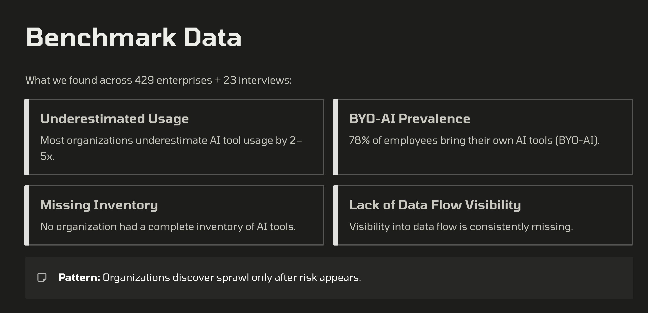
Download report at https://benchmark.peridot.company/
https://peridot.company
© Copyright 2026 Peridot

Slide 13



INTRODUCING PERIDOT
Your Comprehensive AI Sprawl Solution
Peridot provides the critical capabilities needed to gain control over AI tool sprawl, transforming uncertainty into actionable insight.
Visibility into AI Tools
Usage & Data Tracking
Data Exposure Monitoring
Peridot gives you a complete, real-time inventory of all AI tools in use across your organization, enabling you to identify sprawl early.
Monitor who is using what AI tools, how frequently, and with what types of data, providing the foundation to enforce robust governance.
Actively track and alert on sensitive data exposure within AI prompts and outputs, significantly helping to reduce critical risks.
https://peridot.company
© Copyright 2026 Peridot

